Slide 1
Quick Guide for iPad
PAD01 Plug-in Dimmer
Philio Technology Corporation
EASYFIKS SMART HOME

Slide 2
Contents
I、 Where to Use
II 、 Include Device
III、 Exclude Device
IV 、 Sensor Settings
1. Change Sensor Name
2. Delete Log
V 、 Room Settings
1. Add new Room
2. Delete Sensors in the Room

Slide 3
Contents
3. Delete Room
VI、Scene Settings
1. Intruder Alarm
2. Add new scene
3. Operate scene
VII 、 Macro
1. Add new Macro
2. Setting up IF
3. Setting up Then

Slide 4
Contents
VIII、Schedule
1. Add new Schedule
2. Add Macro on Schedule

Slide 5
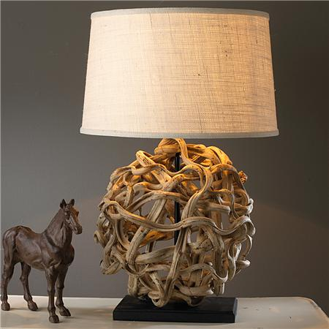
Where to Use

Slide 6
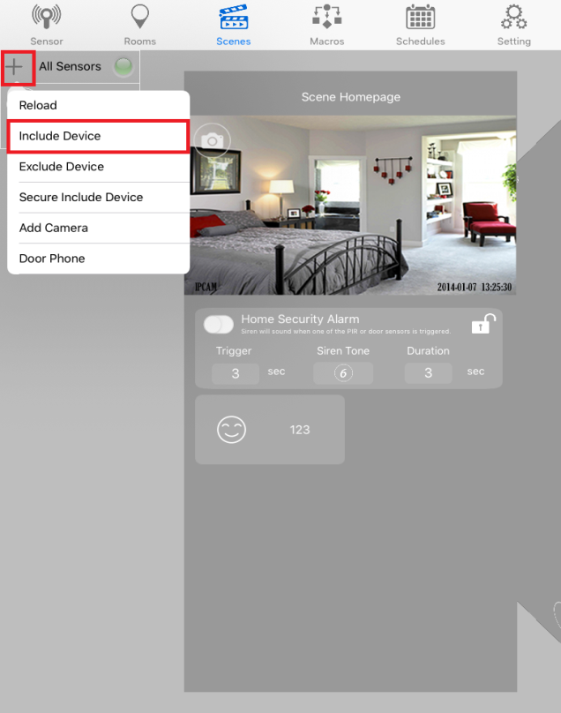
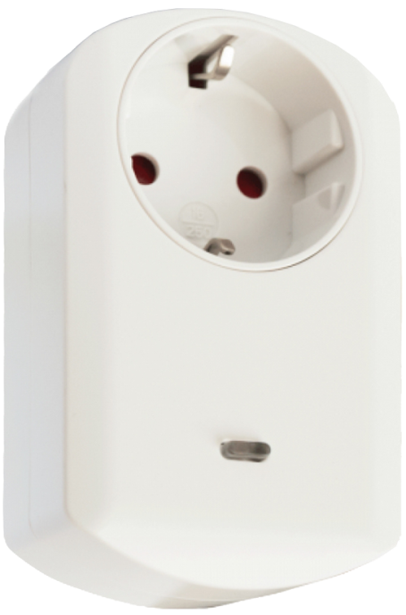
Include Device
1. Plug PAD01 into the outlet.
2. Click on the setting icon and select “Include Deice”.
3. Press the button three times.

Slide 7
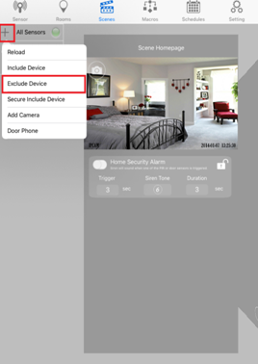
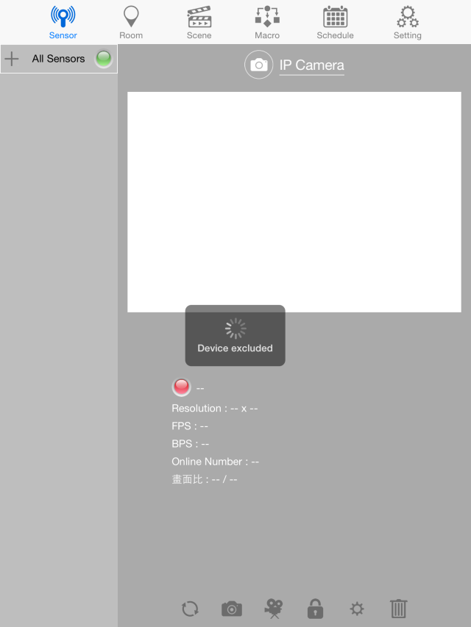
Exclude Device
2. Press tamper key on the device 3 times then the red light LED will flash.
1. Click on the + icon and select “Exclude Device”.
3. Device excluded then the device is in the inclusion mode.

Slide 8
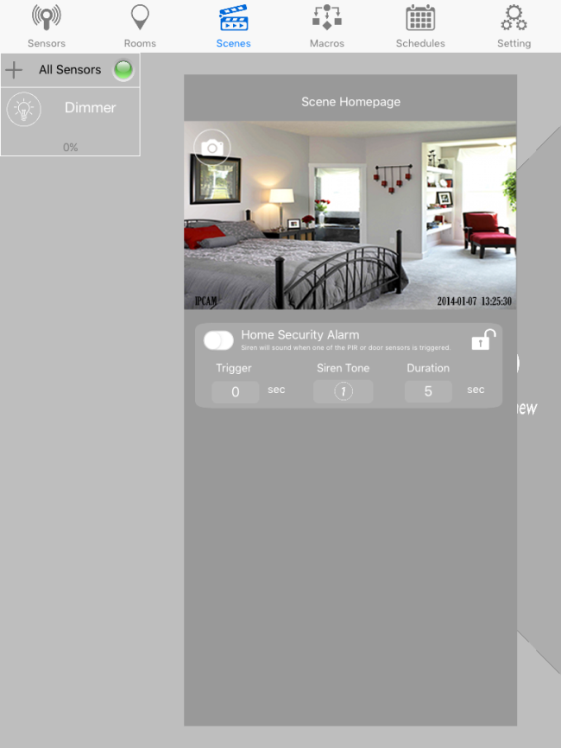
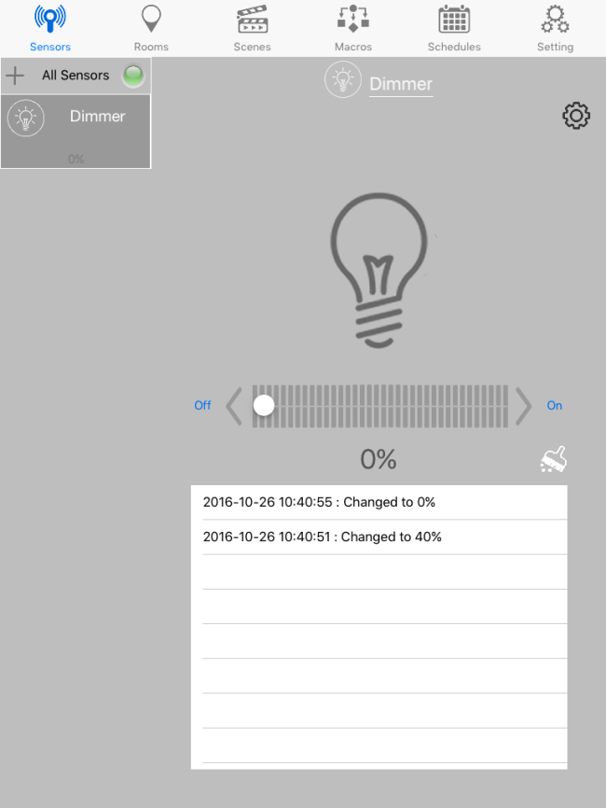
Sensor Settings
1. Click on the sensor which you want to see the information.
2. A new window will open with the information.

Slide 9
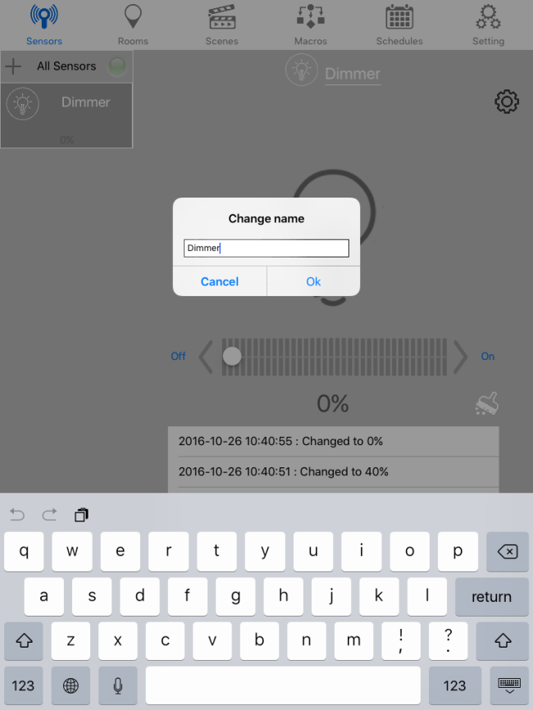
Sensor Settings
Change Sensor Name
1. Click on the name of the sensor.
2. Change the name of the sensor and click OK.

Slide 10
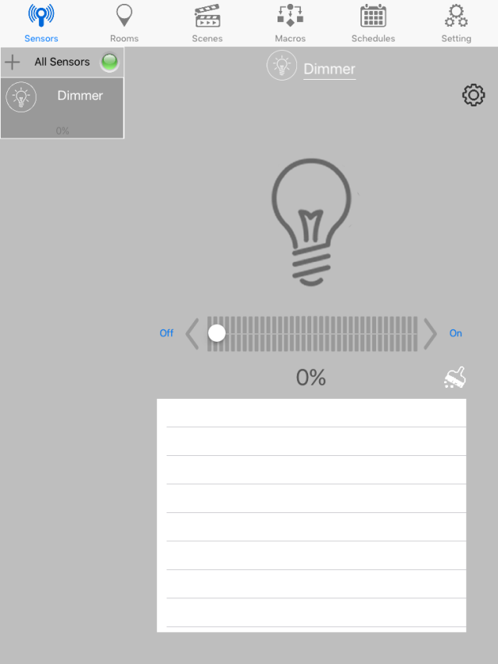
Sensor Settings
Delete Log
1. To delete log, click on the brush tool
2. Once click, all log will be removed.

Slide 11
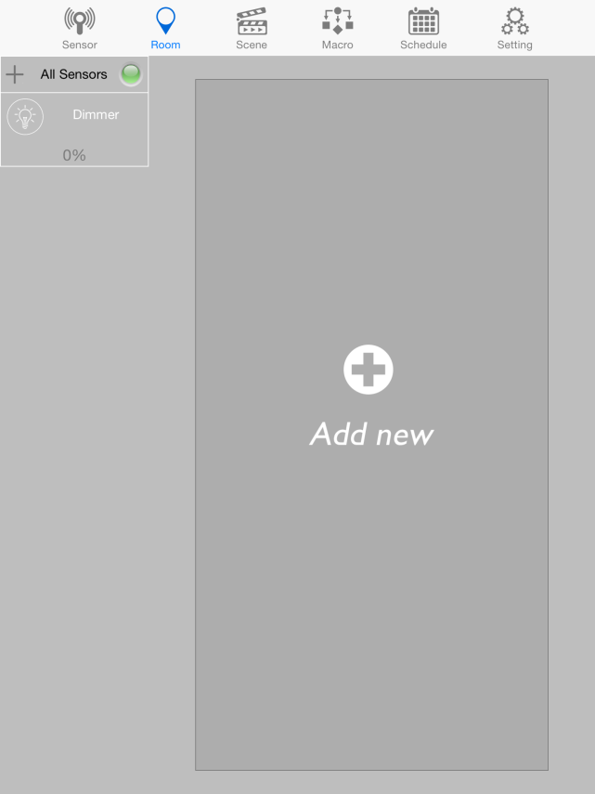
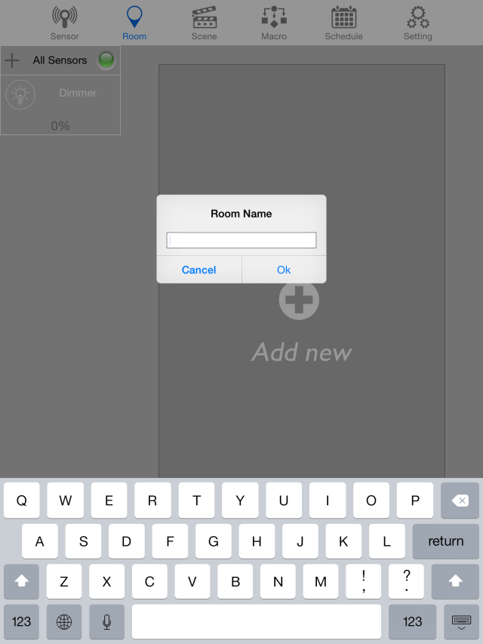
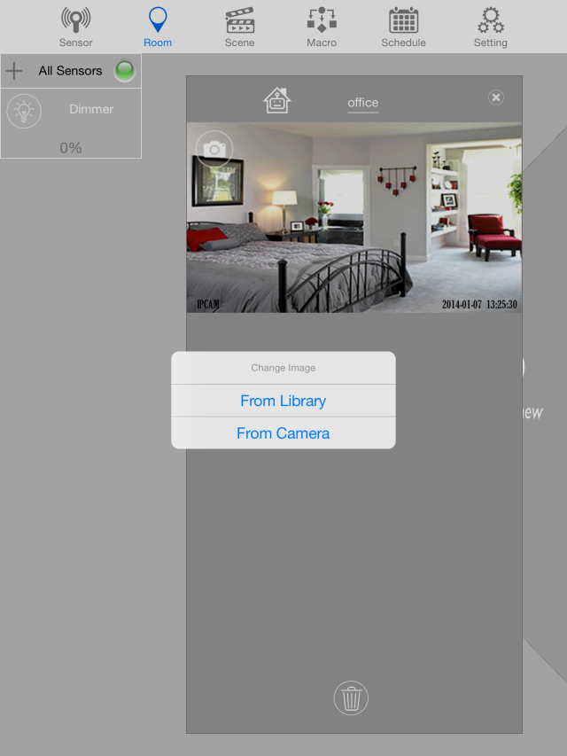
Room Settings
Add new Room
1. Click “Add new” to create a new room
2. provide a name for the room
3. a new window will be formed to sort the sensors and you can choose photo from library or camera by clicking camera icon.

Slide 12
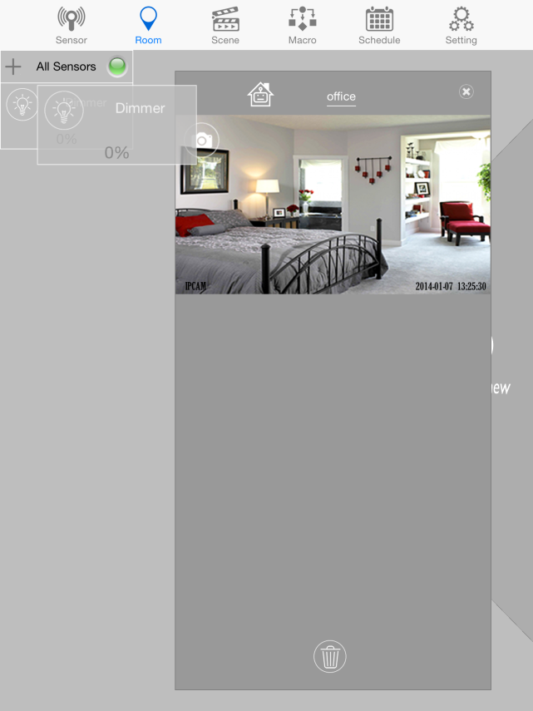
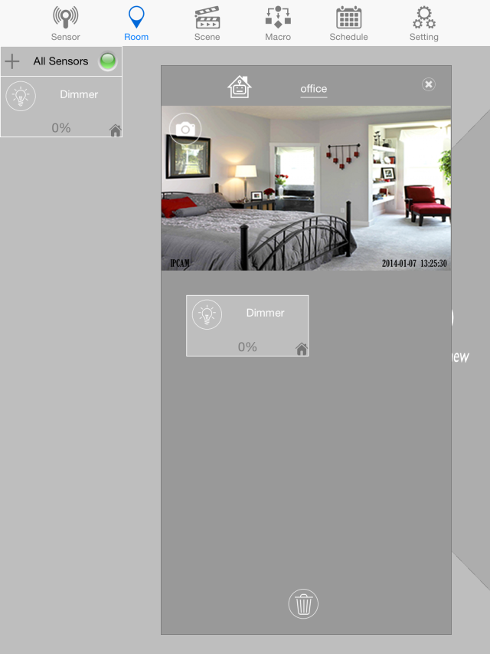
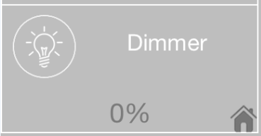
Room Settings
Add new Room
When a sensor has been placed in a room, a house icon will appear. This means this sensor can't be on another room.
4. Click the sensor until it floats, and drag it to the new window
Note: There's no limitation to the number of rooms created or the number of sensors placed in one room.

Slide 13
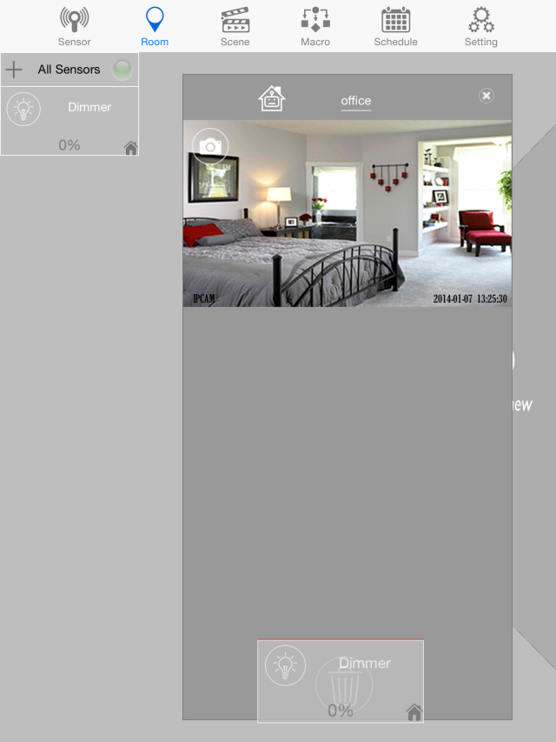
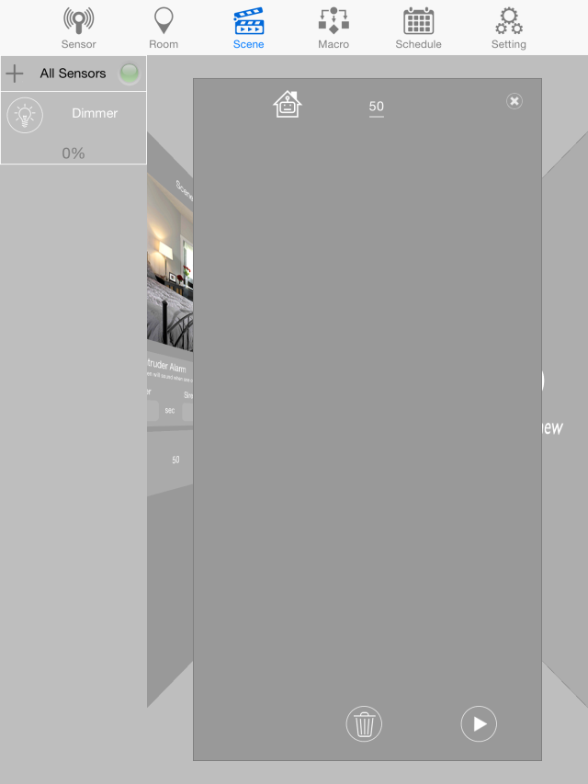
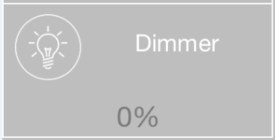
Room Settings
Delete Sensors in the Room
the house icon is also removed.
1. click the sensor inside the room until it floats, and drag it to the trash icon.
2. When deleted, the sensors will not be seen in the room.

Slide 14
Room Settings
Delete Room
1. to delete a room, click the “x” icon on the upper right part of the window.
2. When deleted, it backs to “Add new” page.

Slide 15
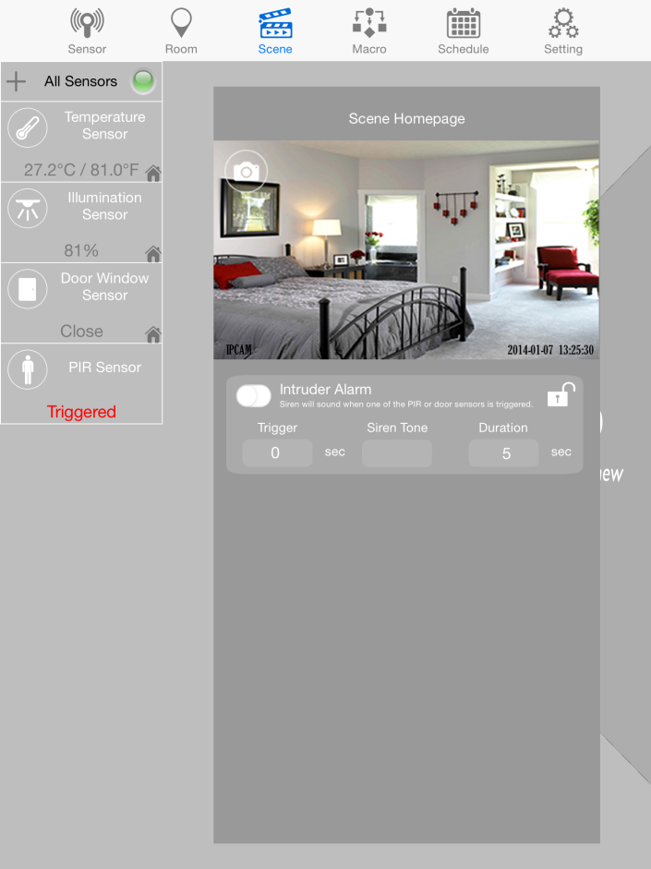
Scene Settings
Intruder Alarm
To activate armed and disarmed mode.
during armed mode, the padlock icon will be closed, and disarmed mode, padlock will be opened.
Trigger: allows you to set the duration for triggering the alarm in armed mode.
Siren Tune: allows users to decide which tune to be used. There are six tunes to choose from.
Duration: set the duration of the alarm.
Note: Only Siren, Marco, Curtain, Dimmer or Switch can be added in Siren

Slide 16
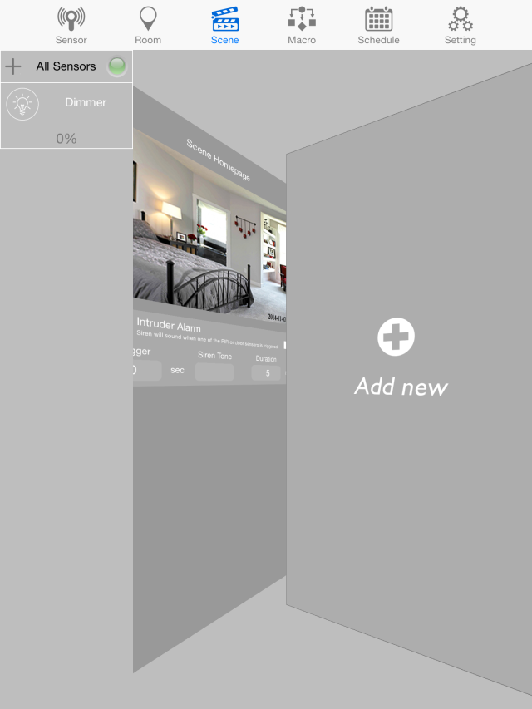
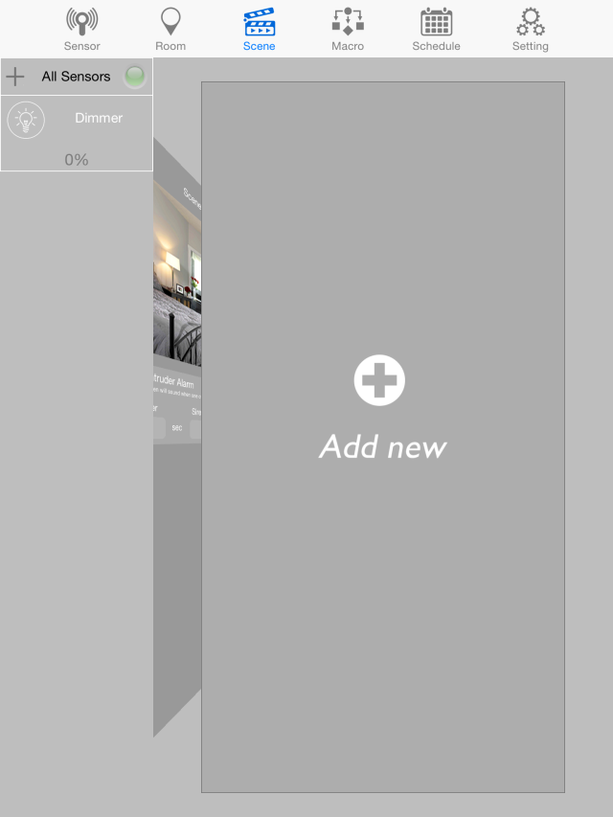
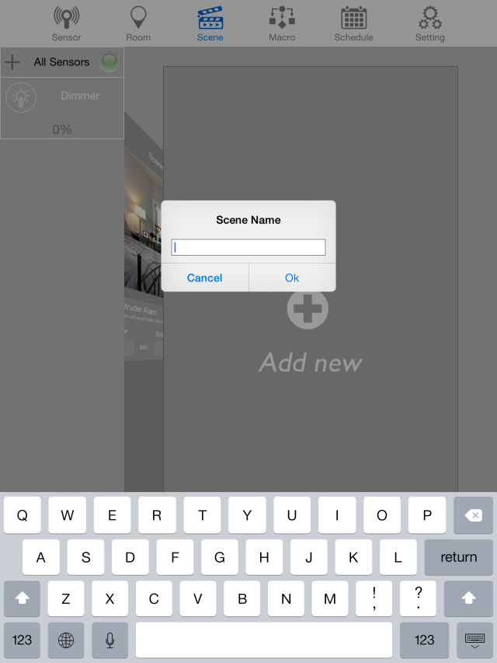
Scene Settings
Add new scene
1. Swipe page from right to left, to start a new scene
2. Provide a name for the Scene
3. a new window will be formed to sort the sensors and you can choose photo from library or camera by clicking camera icon.

Slide 17
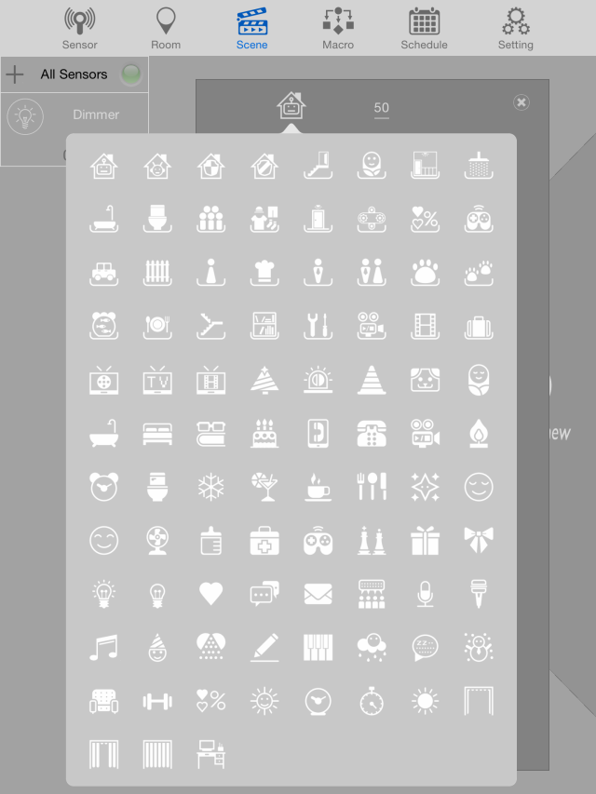
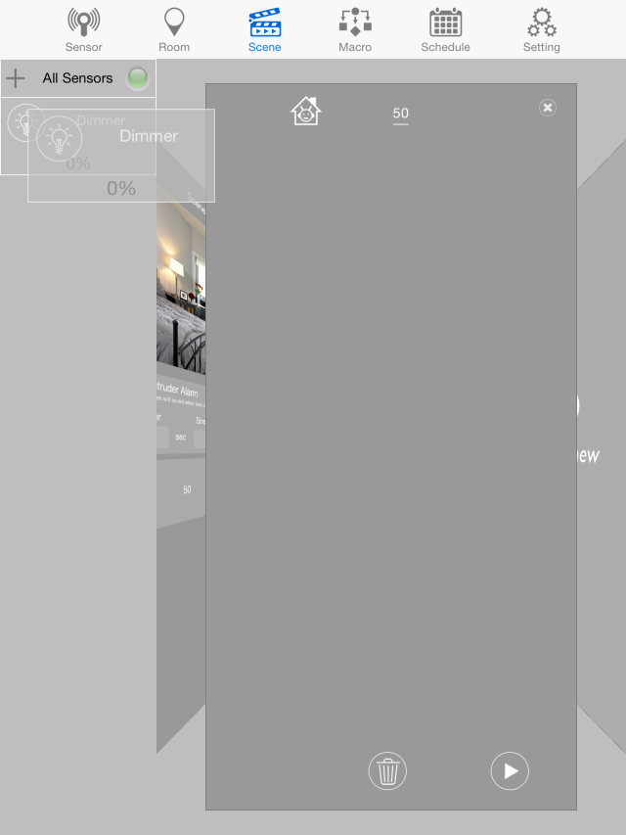
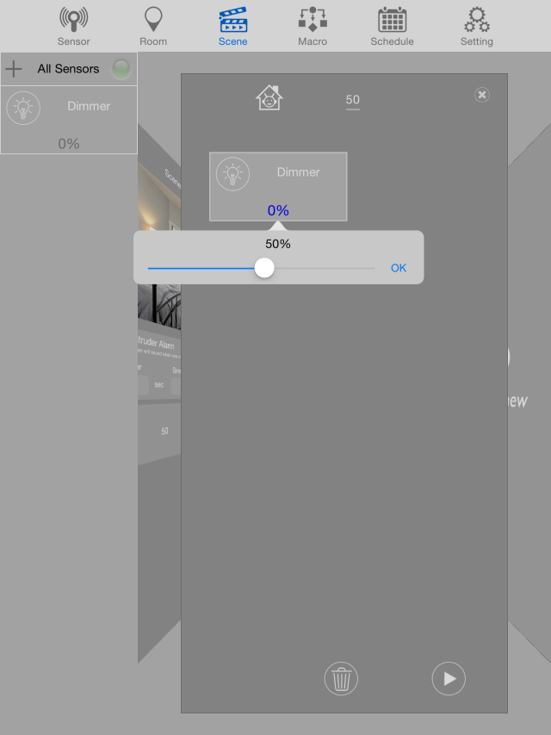
Scene Settings
Add new scene
4. A New window will be formed to place the sensors and you can select the icon
5. Click the sensor until it floats, and drag it to the new window.
6. Set the sensor according to desired scene

Slide 18
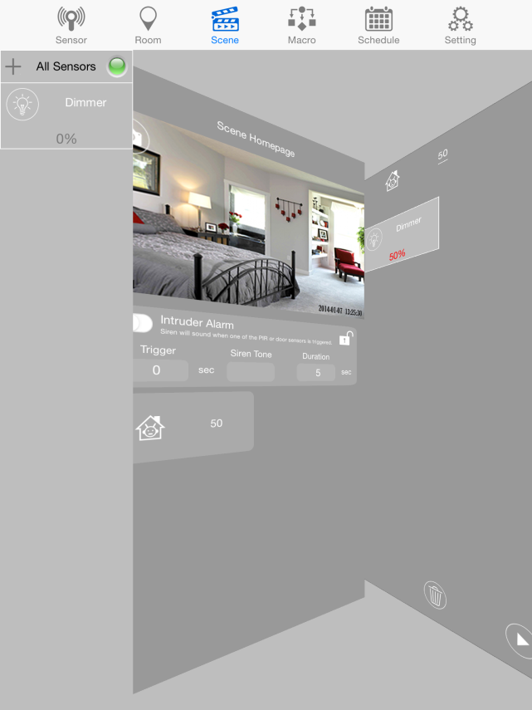
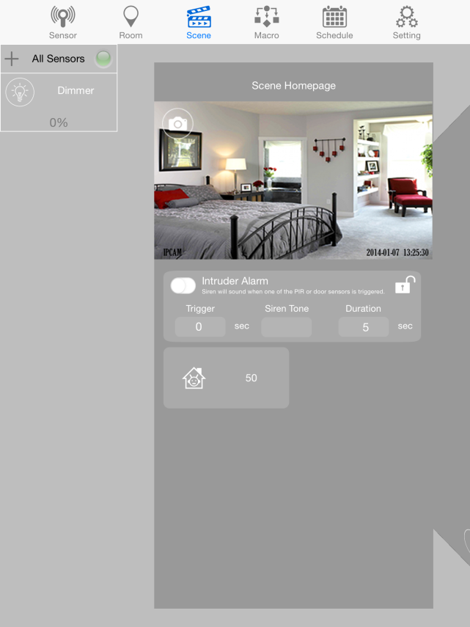
Scene Settings
Operate scene
3. Click on the scene and sensors will do what it was set to do.
Note: There's no limitation to the number of scenes created or the number of sensors placed in one scene.
1. Swipe page from left to right, to the scene page
2. On the home page, there will be a button with the scene name.
Notes:
18

Slide 19
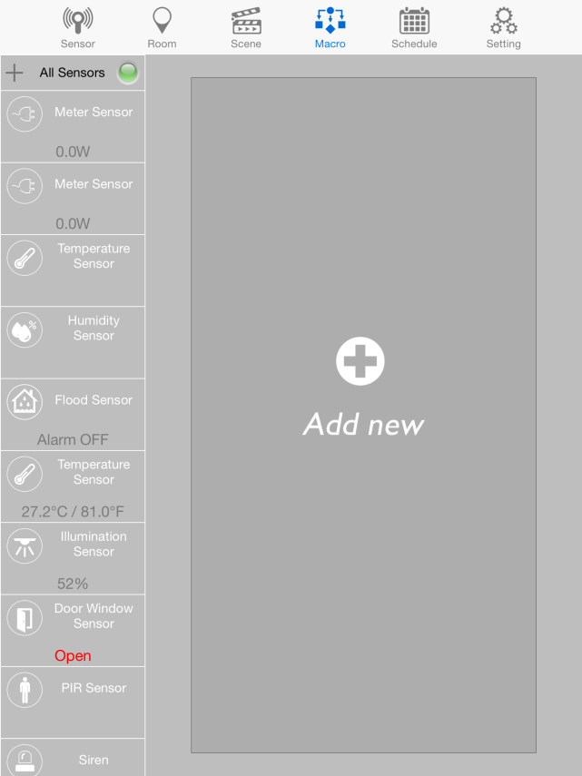
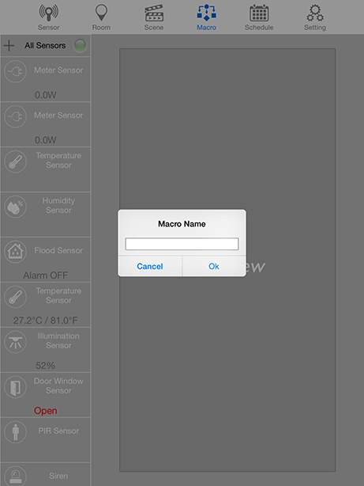
Macro Settings
Add new Macro
Door sensor
If Door open
Then Dimmer 50%
Dimmer
1. click “Add new” to make a new macro
2. provide a name for macro and click OK.
Example : macro

Slide 20
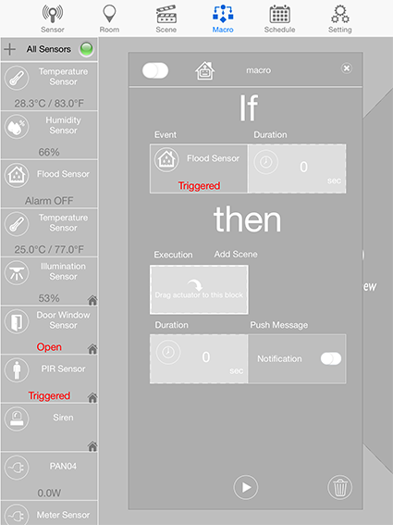
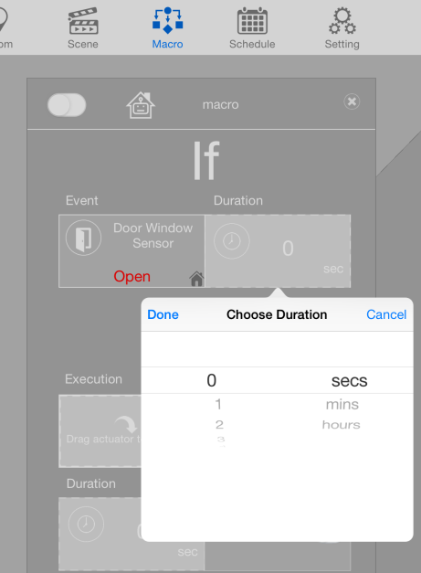
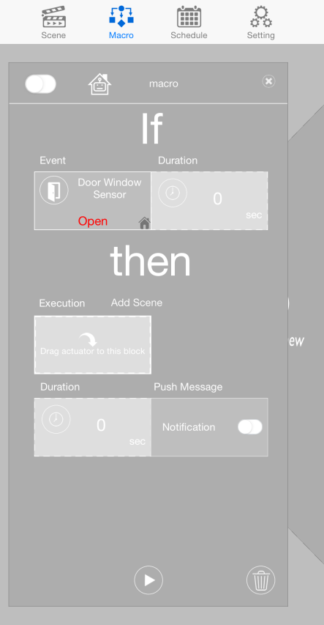
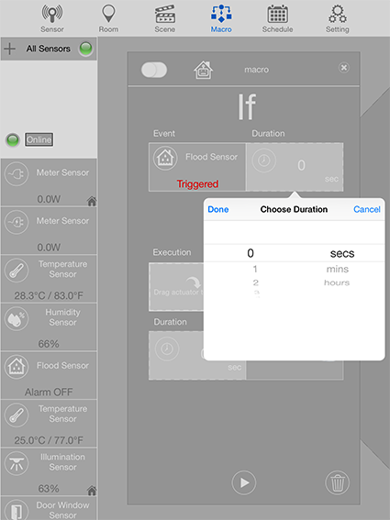
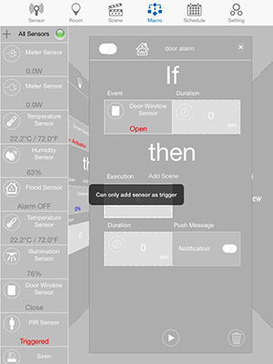
Macro Settings
Setting up IF
3. click and drag the sensor that you want an event to occur.
4. click on the "Duration" to set time duration needed for event to trigger.
5. only sensors can be placed on the event.

Slide 21
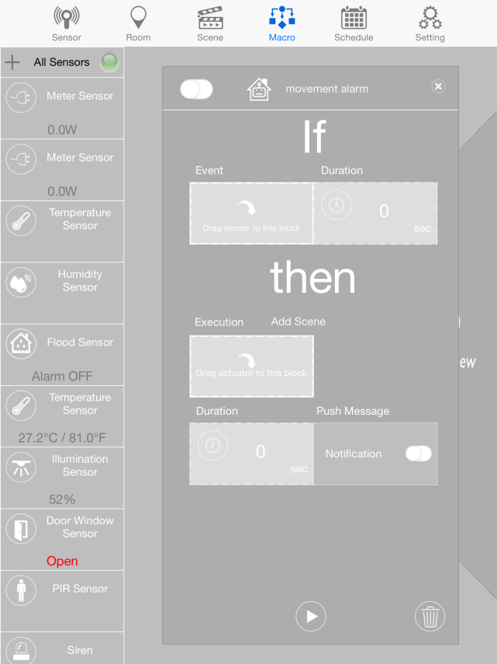
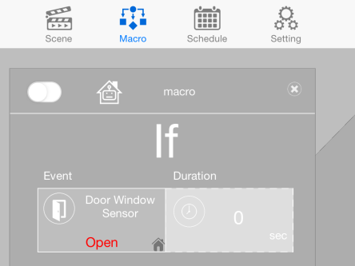
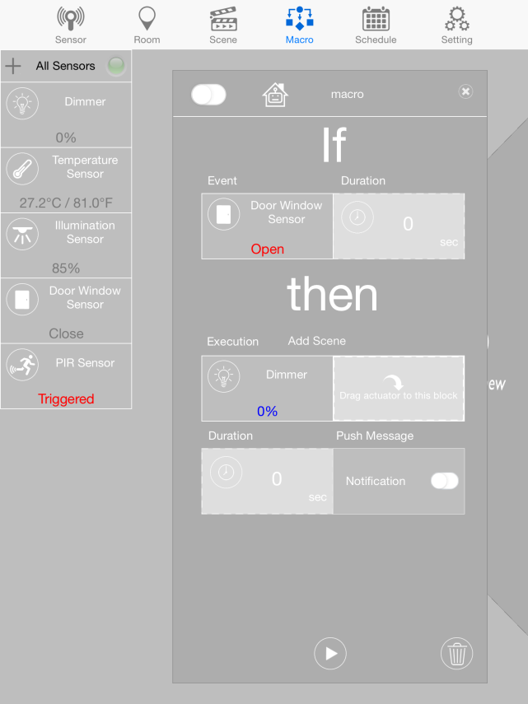
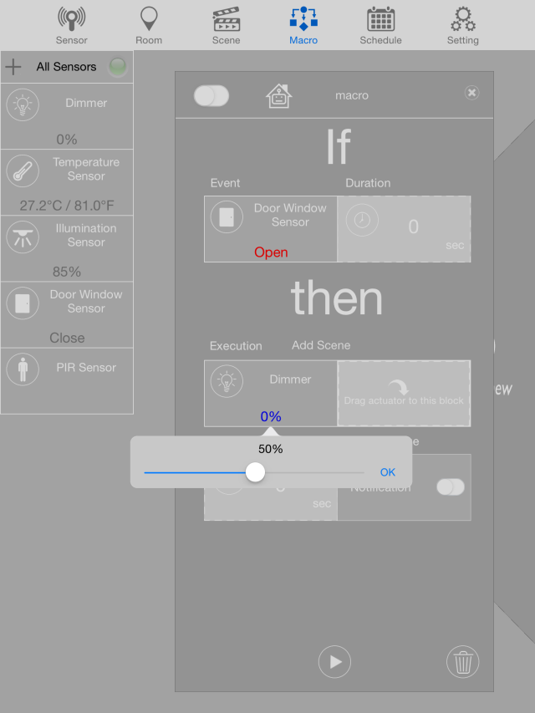
Macro Settings
Setting up Then
6. for the Execution, you can either add actuators or add scene.
7. click and drag the actuators that you want to react to your “If” .
8. to set up the actuator, click on the actuator itself and choose from the options.

Slide 22
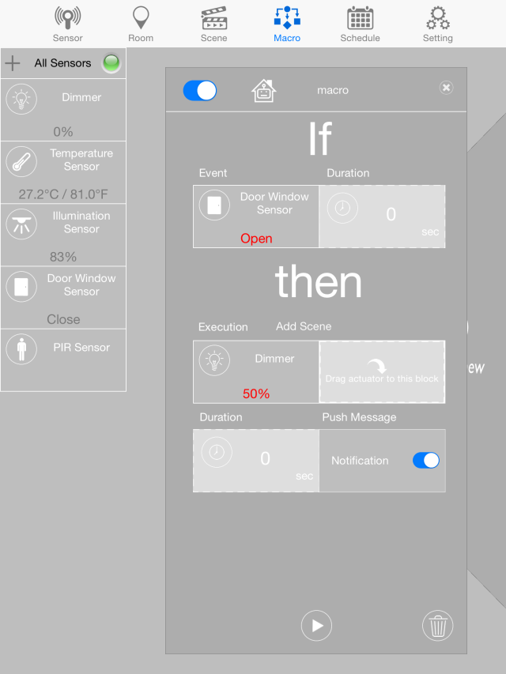
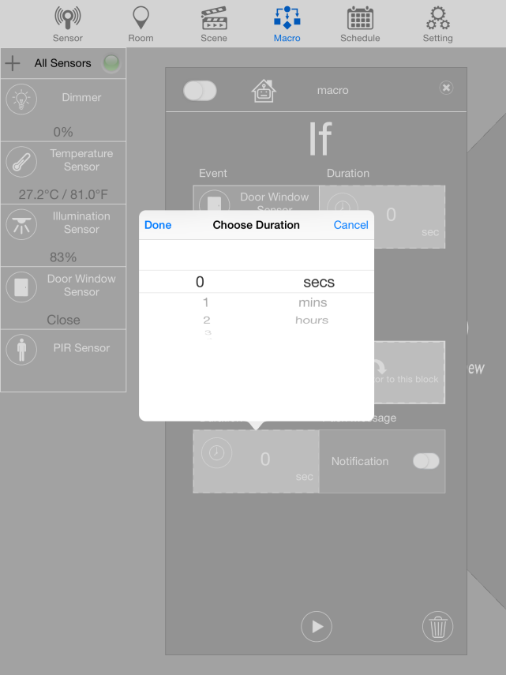
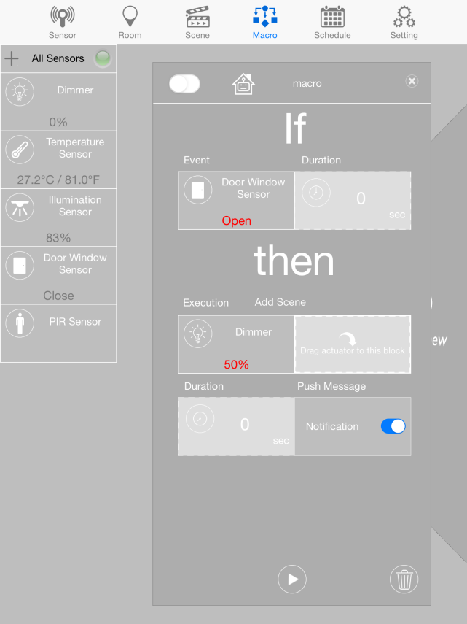
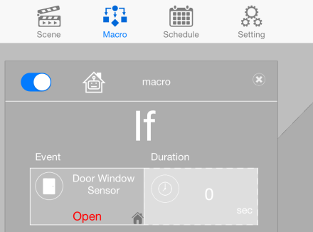
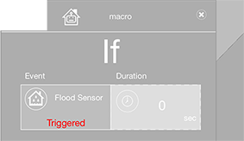
Macro Settings
Setting up Then
11.
12.
9. click on the "Duration" to set time duration for executing event.
10. to receive notification if triggered, tap the switch beside the notification.
11. To turn on the Macro, tap the this switch .
12. to play the macro, click on the play icon.

Slide 23
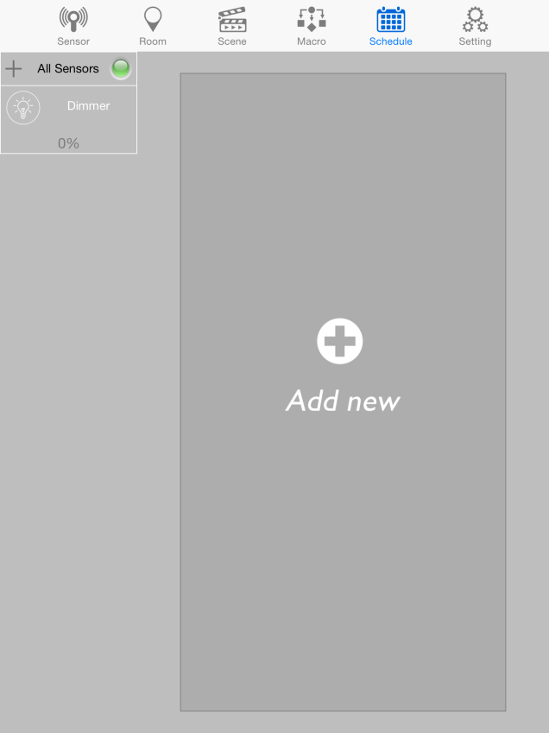
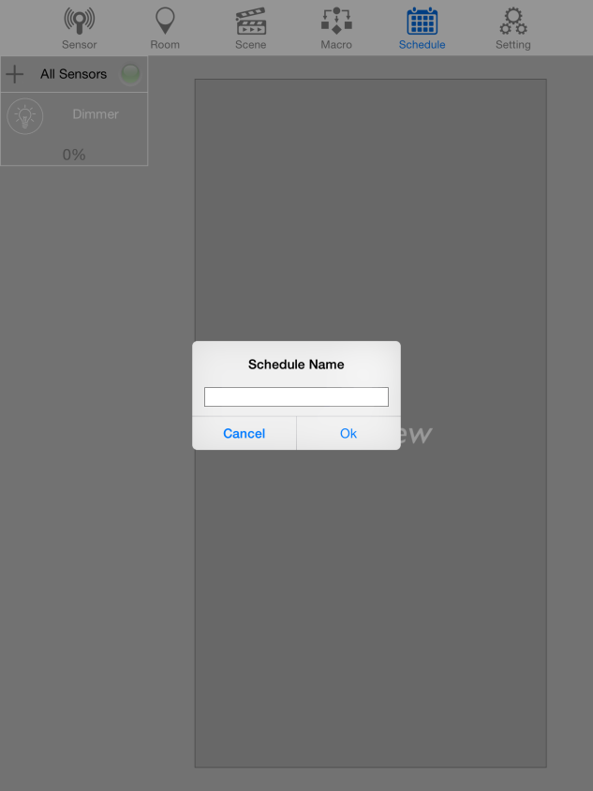
Schedule Settings
Mute
1. click “Add new” to make a new schedule.
2. provide a name for schedule and click OK.
NOTE: Only Siren, Meter, Curtain, Dimmer or Switch can be added in Schedule.

Slide 24
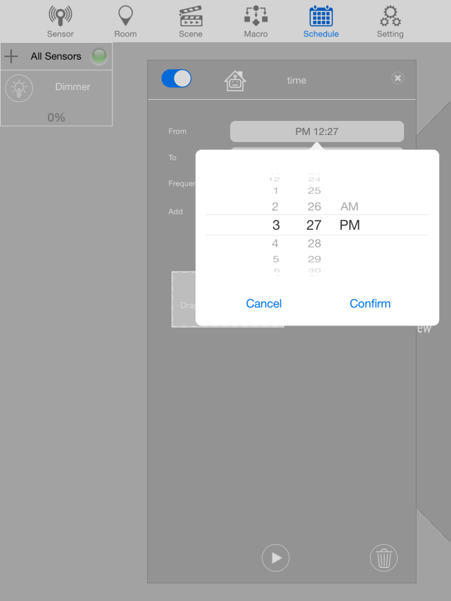
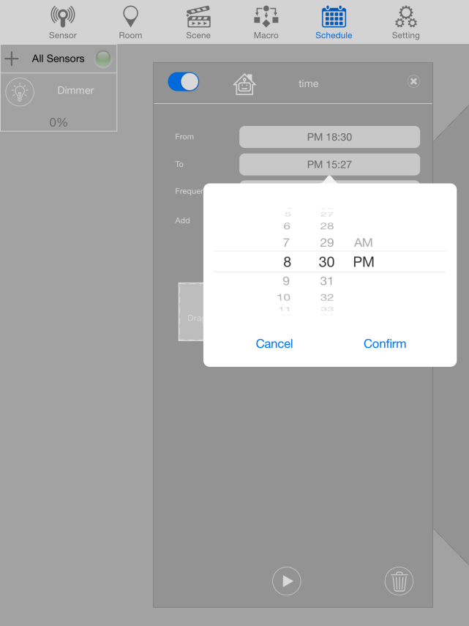
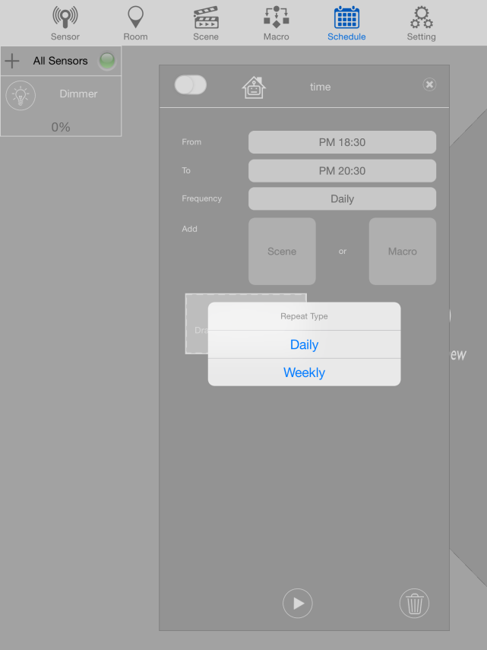
Schedule Settings
Add new Schedule
3. Set From (starting time) and click “Confirm”.
4. Set To (ending time) and click “Confirm”.
5. Select Daily or Weekly to the Repeat the schedule.

Slide 25
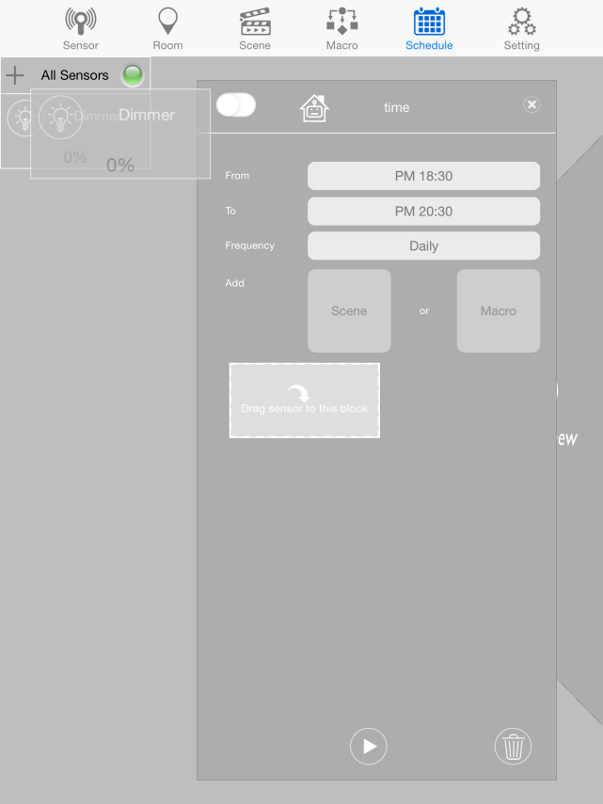
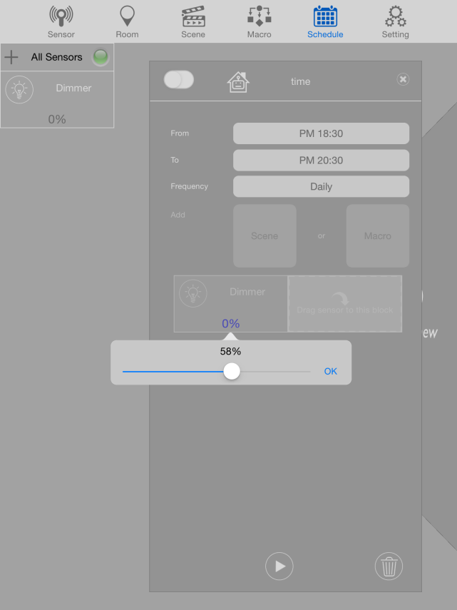
Schedule Settings
Add Macro on Schedule
8.
9.
6. Click and drag the device you which to schedule.
7. To set up the device, click on the device itself and choose from the options
8. To turn on the Schedule, tap the this switch .
9. To play the Schedule, click on the play icon.

Slide 26
Schedule Settings
Add Scene on Schedule
3.
A
B
4
1. Click the Scene(A) and Select preferred off (B) to add.
2. only the actuators of the macro will be displayed.
3. To turn on the Schedule, tap the this switch .
4. To play the Schedule, click on the play icon.

Slide 27
EASYFIKS SMART HOME
Notes:
27
27

