Slide 1
Quick Guide For sensors
PST02-A
PST02-B
PST02-C
4 in 1 Multi-sensor
3 in 1 Sensor
3 in 1 Sensor
PSP05-B
PSP05-C
PSP05-D
Waterproof Motion sensor
EASYFIKS SMART HOME

Slide 2
Contents
I、 PST02 Seriers
II、Where to Use
III、Include Device
IV 、Exclude Device
V、Sensor Settings
1. Change Sensor Name
2. Delete Log

Slide 3
Contents
VI 、Room Settings
1. Change room image
2. Move to a different room
VII 、Scene
1. Intruder Alarm
VIII、Marco
IX 、 Schedule

Slide 4
PST02 Series
PST02-B
PIR
Temperature
Illumination
PST02-C
Door/Window
Temperature
Illumination
PST02-A
Door/Window
PIR
Temperature
Illumination

Slide 5
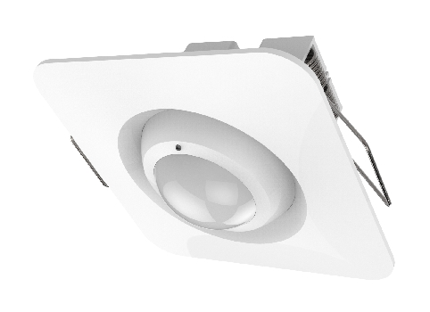
PSP05 Series
PSP05-C
Waterproof
Motion detection
Distance 12 meter
PSP05-D
Waterproof
Motion detection
Distance 12 meter
PSP05-B
Waterproof
Motion detection
Distance 12 meter

Slide 6
Where to Use
160 cm

Slide 7
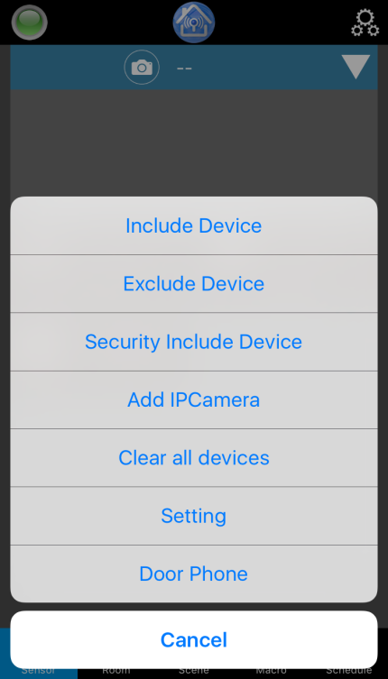
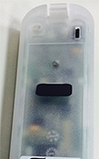
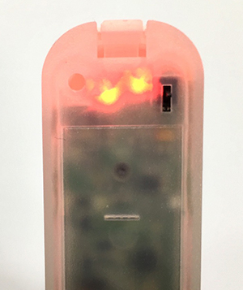
Include Device
1. Remove the black mylar.
2. It will automatically be in the inclusion mode, red light slowly flashing for 30 seconds.
3.While device is in inclusion mode, click on the setting icon and select “Include Device”.

Slide 8
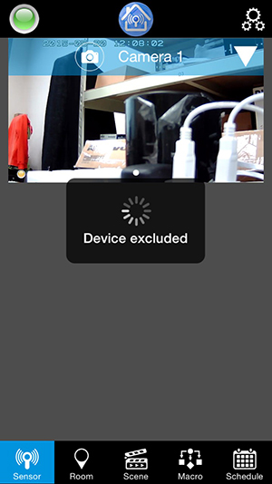
Exclude Device
2. Press tamper key on the device 3 times then the red light LED will flash.
1. Click on the setting icon and select “Exclude Device”.
3. Device excluded then the device is in the inclusion mode.
Note: when device excluded, it will automatically be in the inclusion mode, red light slowly flashing for 30 seconds.

Slide 9
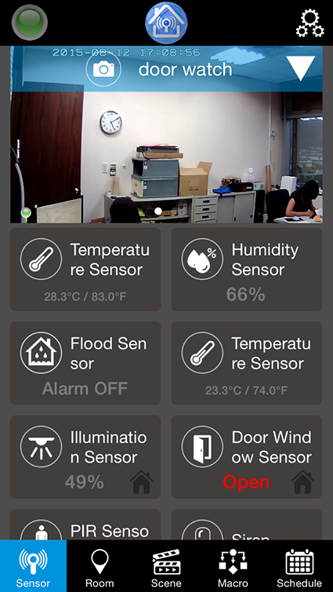
Sensor Settings
1. Click on the sensor which you want to see the information.
2. A new window will open with the information.

Slide 10
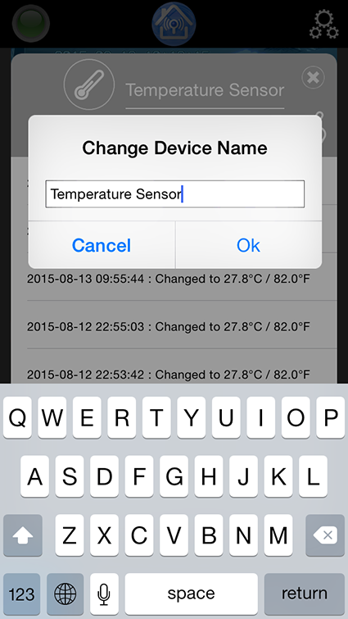
Sensor Settings
Change Sensor Name
1. Click on the name of the sensor.
2. Change the name of the sensor and click OK.

Slide 11
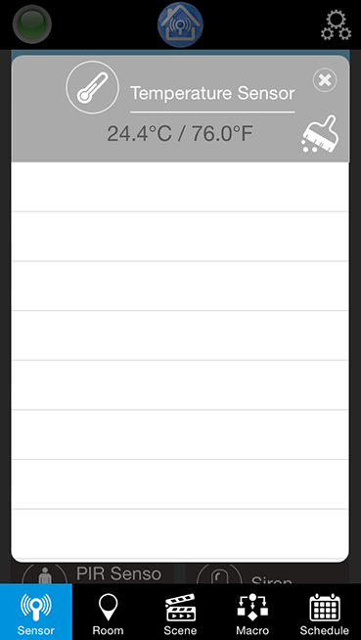
Sensor Settings
Delete Log
1. To delete log, click on the brush tool
2. Once click, all log will be removed.

Slide 12
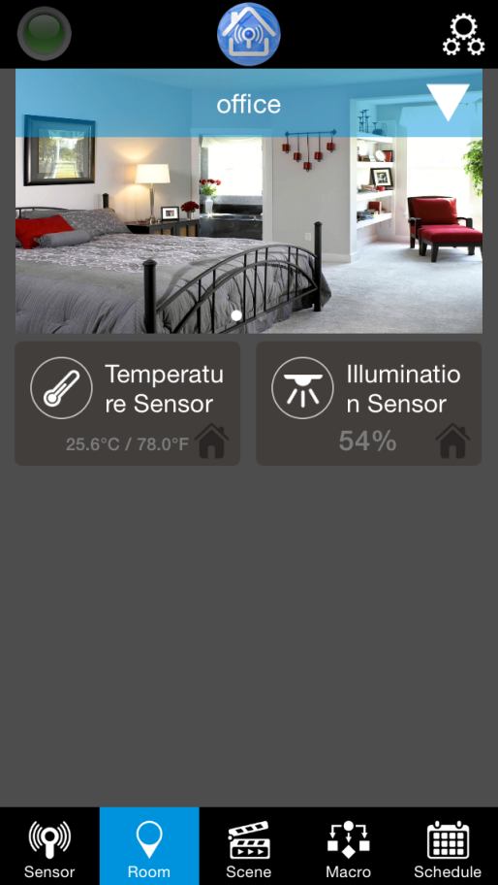
Room Settings
All settings are needed to be done in Tablet/Pad/Advance Settings (web user manual).
When room is created, the selected devices are located in the room.

Slide 13
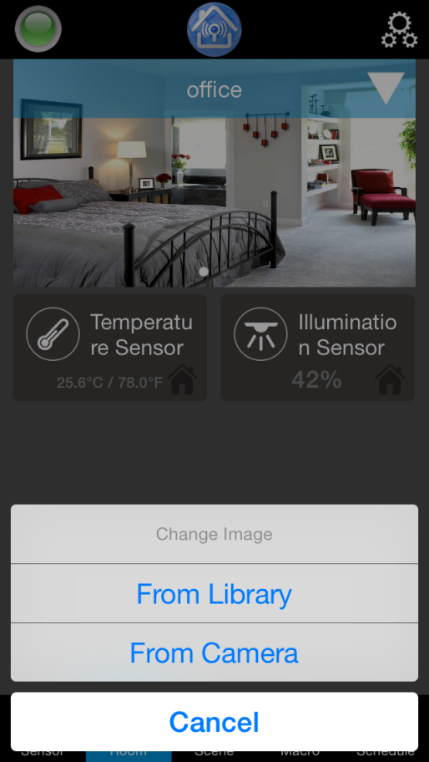
Room Settings
Change room image
1. Click on the image.
2. You can opt to choose an image from Library or from Camera.
Note: Images are done locally, so any image change done in room will only remain on that devices.

Slide 14
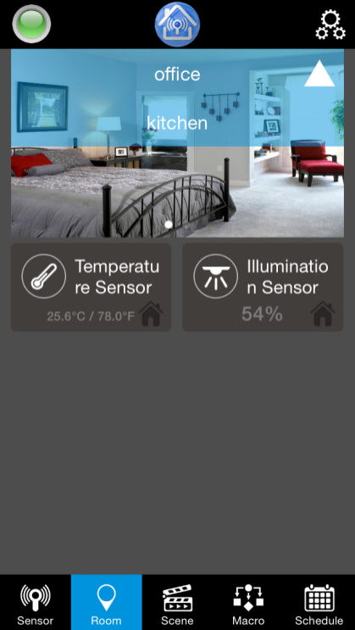
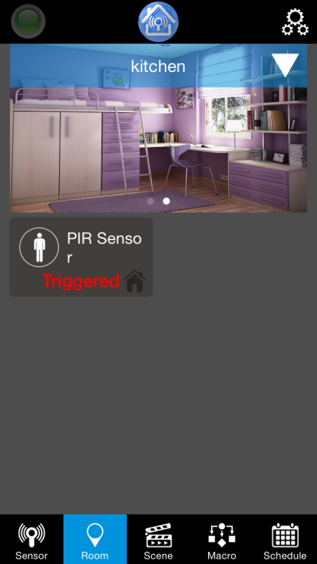
Room
Move to a different room
1. Select the down arrow on the upper right side.
2. Select the room you want to view.
3. It will show the sensors on the selected room.

Slide 15
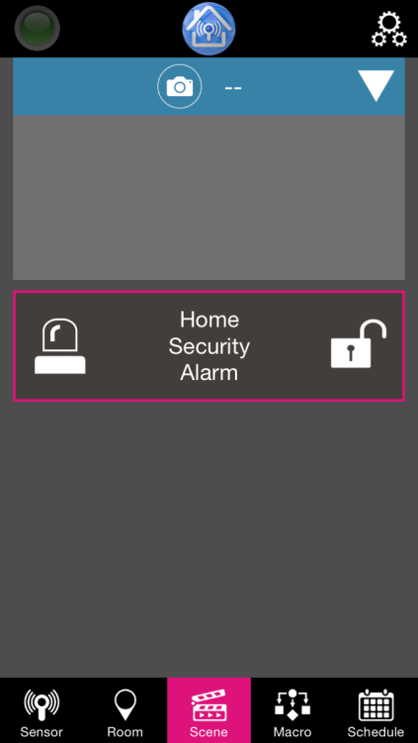
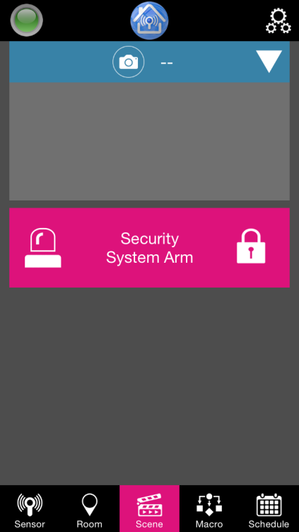
Scene
Intruder Alarm
To activate armed and disarmed mode, click the lock.
During armed mode, the padlock icon will be close, and the box will be in pink.

Slide 16
Macro
All settings are needed to be done in Tablet/Pad/Advance Settings.
When marco is created, you can activate or deactivate the marco.

Slide 17
Schedule
All settings are needed to be done in Tablet/Pad/Advance Settings.
When schedule is created, you can activate or deactivate the schedule.

Slide 18
EASYFIKS SMART HOME
Notes:
18
18

